Slide 1
INCome Predıctıon on Adult Data
Rıdvan Salih Kuzu

Slide 2
DATA PREPARATION
Adult data is parsed to 17 columns, after that ID and income columns is removed because they are not the features to be used in modelling.
Last column (target) are separated for model labelling
Categorical features like work-class, education, marital-status, occupation, relationship, race, sex and native-country are encoded due to the fact that they can be used with other numerical features together.
Some of the columns like work-class, native-country and occupation have missing values. These are replaced with most frequent values along the axis by using an imputer function.
Finally data is randomly split into train and test parts (75%-25% division)

Slide 3
DEVELOPING AND VALIDATING MODEL
Train data is fitted with the standard scaler, after that test data is transformed by using scaling coefficients of train data.
9 different classification methods are selected to compare model performances and determining best model on them. These are:
Random Forest, Extreme Learning Machine, Multilayer Perceptron, Logistic Regression, Linear Discriminant Analysis, KNN, Decision Tree, Naïve Bayes and SVM
10-fold cross validation on train data is conducted in order to determine the model which gives the best accuracy.
Among these supervised learning methods, Random Forest gives the highest accuracy.
In order to determine the best method more precisely, grid search on each classifier by fine-tuning their hyper-parameters can be executed. Nevertheless, it took more than 1-day, and I decided to use each model with their default hyper-parameters. (Still, the code for grid search can be observed on my source-code).
At the end, the prediction is executed on test data by using Random Forest Classifier.

Slide 4
INTERPRETATION OF THE MODEL OUTPUTS
As seen in Appendix-1, people having master, doctorate or prof-school are likely to gain more than 50K.
As seen in Appendix-2, in case of occupation, executive managerial have highest income ratio, while handlers-cleaners and service employees get lower incomes.
As seen in Appendix-3, more education does not result in the same gains in income for Asian Americans/Pacific Islanders, Blacks and Native Americans compared to Whites.
More education also does not result in the same gains in income for women compared to men, moreover high income rate reached its peak at middle ages for both women and men as illustrated in Appendix-4.
Generally older people make more, except for Asian Americans/Pacific Islanders as seen in Appendix-5.

Slide 5
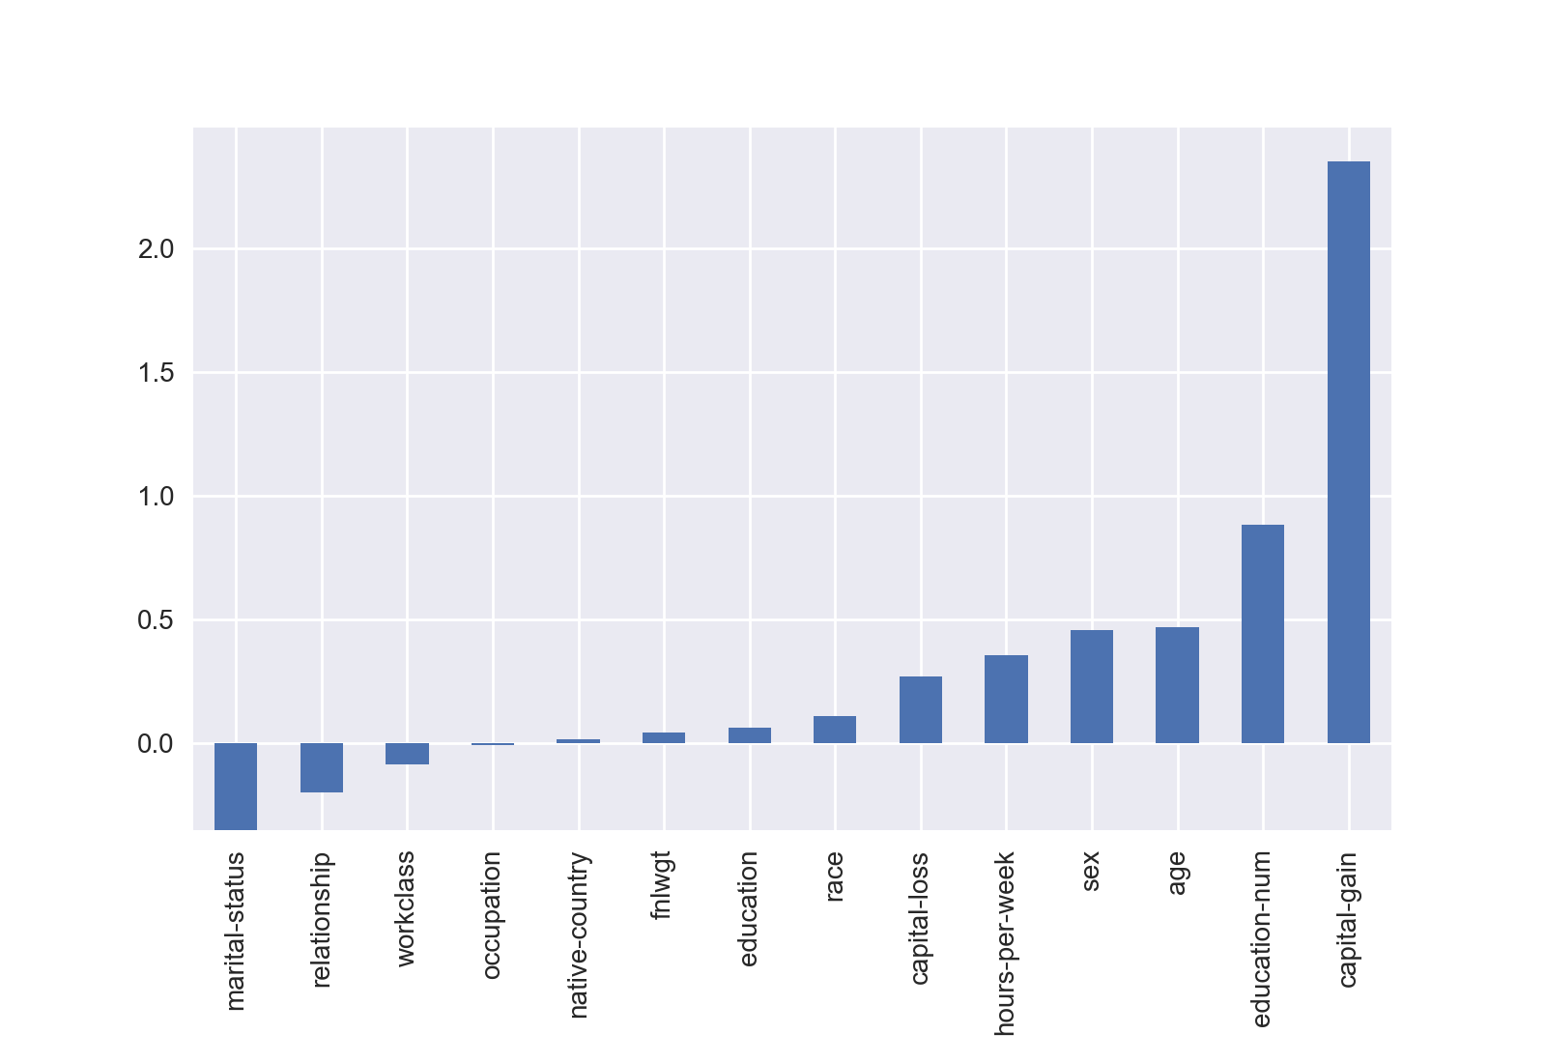
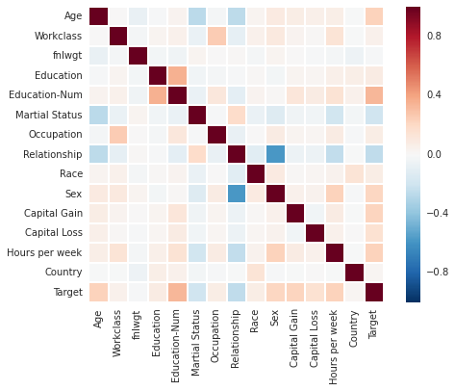
INTERPRETATION OF THE MODEL OUTPUTS
The features that seems to contribute most positively to have an income of more than $50K are Capital Gain, Education-Num and Sex, while the features that contribute most negatively are Marital Status and Relationship. (left figure below)
If we look at the feature heat-map (right below), there is a high correlation between Education and Education-Num, as well as Sex and Relationship seem to be negatively correlated. So, eliminating Education and Relation from the model would not decrease the performance of the ML model.

Slide 6
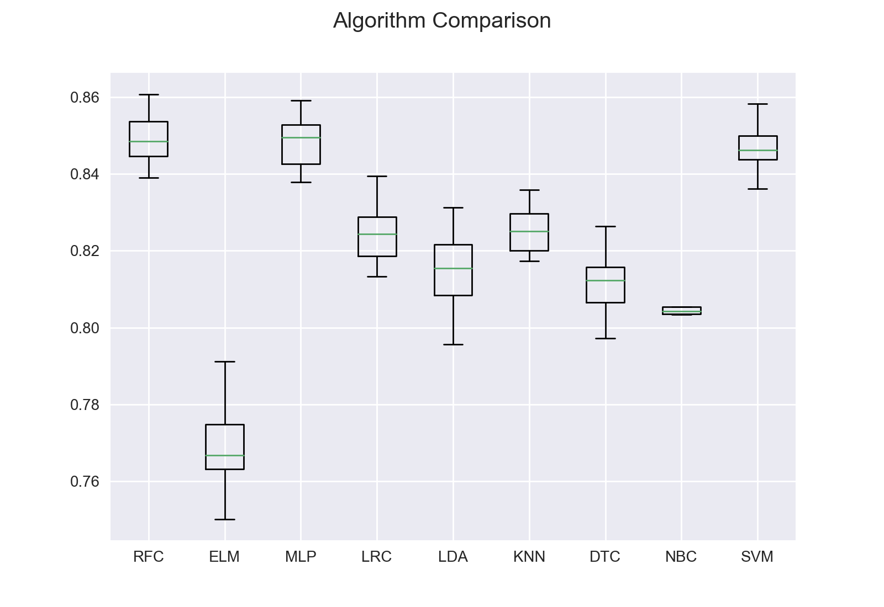
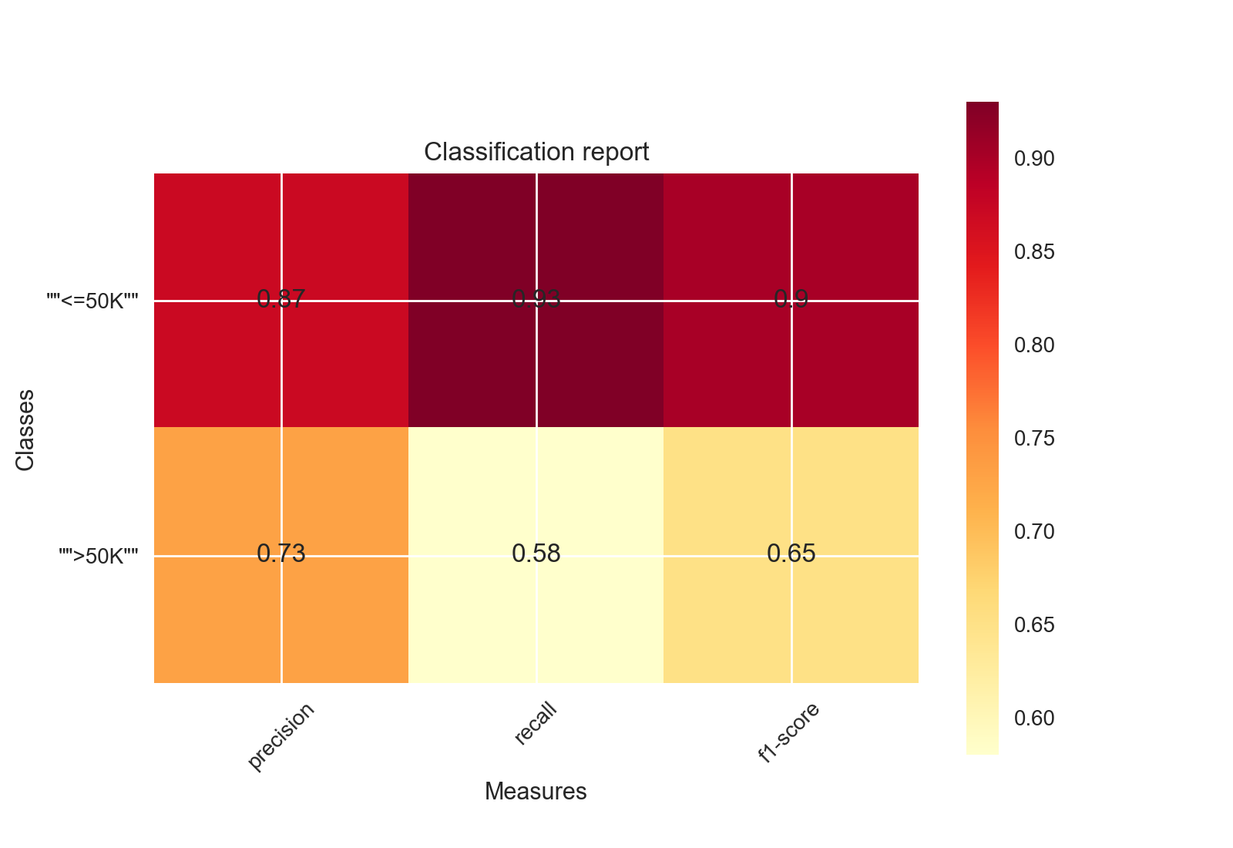
MODEL VALIDATION
As seen on the left below figure, 10-fold cross validation on different models show that Random Forest (RF), Multilayer Perceptron and SVM has similar performances. However, O(n) degree of RF is lower than rest of those models.
By using RF, we have reached following average prediction values on test data:
Precision: 0.84 Recall: 0.85 F1-measure: 0.84
Performance of each class can be seen also on the right figure below:

Slide 7
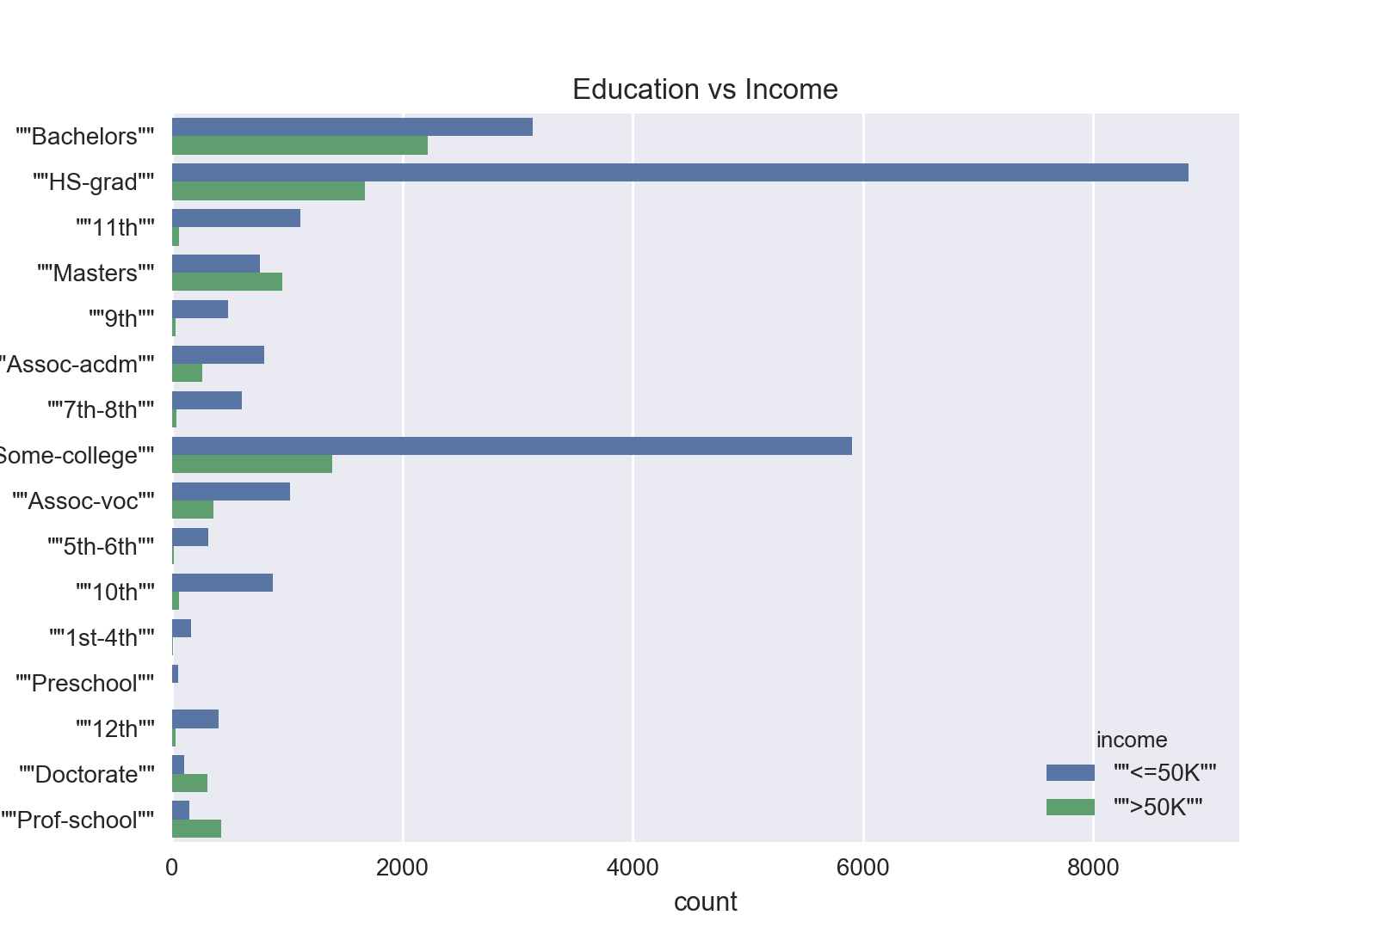
APPENDIX-1

Slide 8
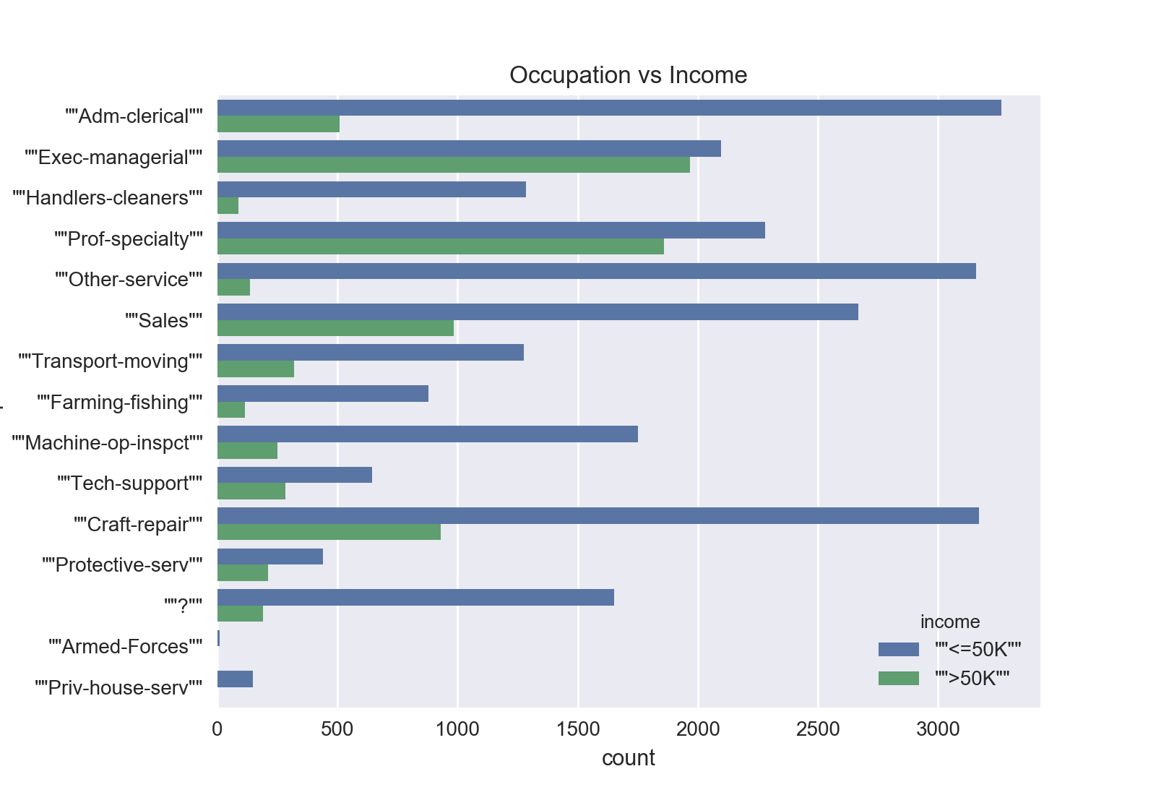
APPENDIX-2

Slide 9
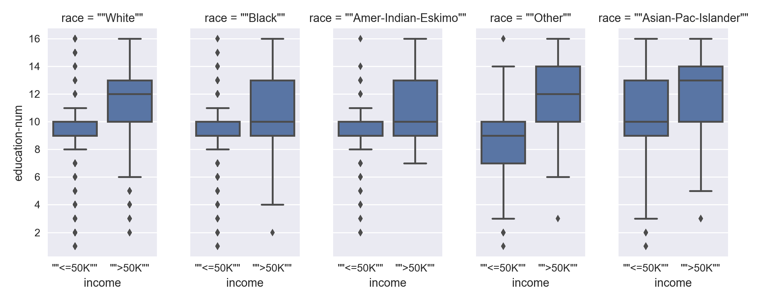
APPENDIX-3

Slide 10
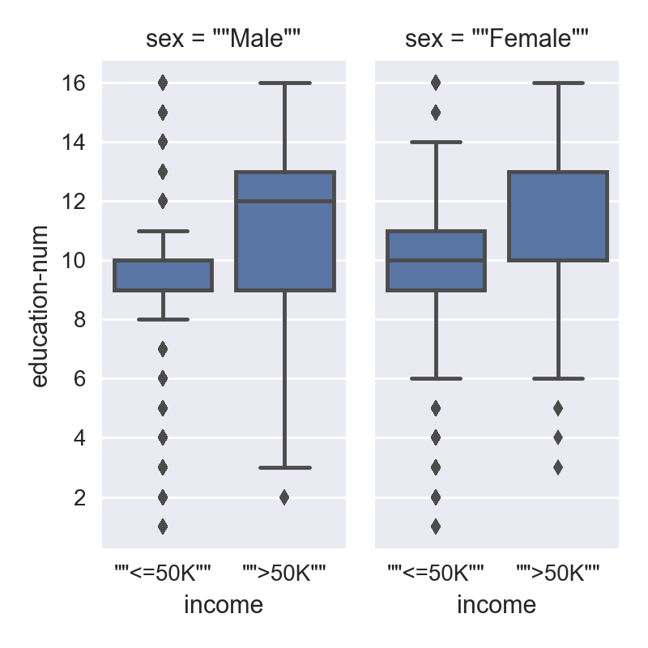
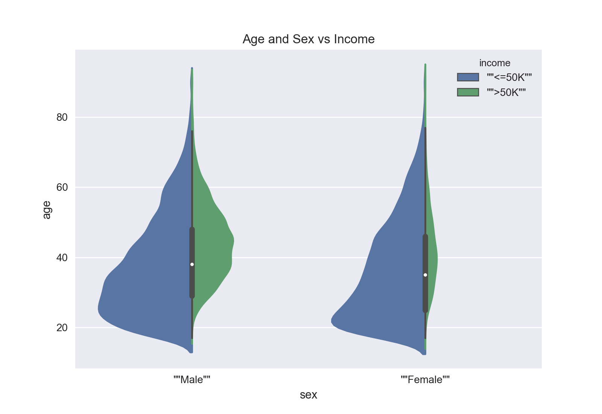
APPENDIX-4

Slide 11
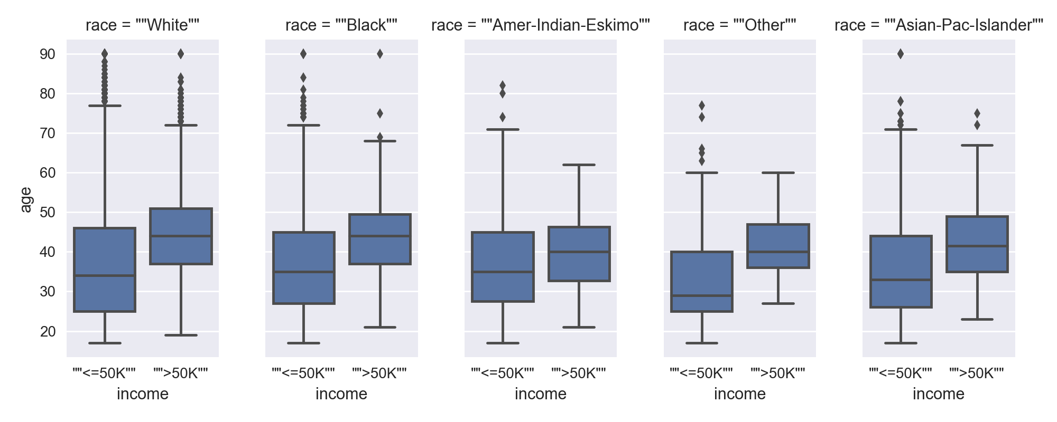
APPENDIX-5

